Slide 1
Web
StyleSheets

Slide 2
Cascading Style Sheet
Web style sheets are a form of separation of presentation and content for web design .
Style sheet can decide the presentation of web pages.
Style sheet takes care of all the layout, fonts, colors and overall look of the site.
Notes:
HTML was originally designed as a simple way of presenting information, with the aesthetics of a web page being far less important than the content (and largely being left up to the web browser). Of course, now that the web has become as popular as it has, the presentation of your content has become almost critical to a site’s success. This, among other things, was why CSS was brought in.

Slide 3

Cascading Style Sheet (contd..)
Principal means of Styling a document using Cascading style sheets are:
Inline style Sheet
Embedded style Sheet
External style Sheet
Notes:
One can use another mechanism of styling documents by using Inline Style sheets
An inline style loses many of the advantages of style sheets by mixing content with presentation. Use this method sparingly, such as when a style is to be applied to a single occurrence of an element.
To use inline styles you use the style attribute in the relevant tag. The style attribute can contain any CSS property. The example shows how to change the color and the left margin of a paragraph:
<p style="color: sienna; margin-left: 20px"> This is a paragraph </p>

Slide 4
Benefits of a Cascading Style Sheet
Pages download faster.
Page contains less code, and the pages are shorter and neater.
The look of the site is kept consistent throughout all the pages that work off the same stylesheet.
Updating the design and general site maintenance are made much easier.
Notes:
Well-authored CSS also improves the accessibility of web content, allowing access through myriad devices (handheld PDAs for example) and ensuring that web users with disabilities are still able to receive it. It also eliminates the need for browser-specific hacks and tags, which means your site has a better chance of working across all major browsers.
Initially vaguely intimidating, CSS is a well-designed, elegant language. It is hugely important for the future of web design, and has been pivotal in helping designers move away from the problematic, hack-ridden days of presentational HTML tags like <font>, and allowed us to return to using logical, structural elements which make our sites more accessible.
All that, and there are dozens of powerful extra formatting options and possibilities available through stylesheet commands that are not possible through normal HTML. You’ll see these later on when we get on to things like backgrounds, spacing, layers and borders.

Slide 5

Parts of a Cascading Style Sheet
CSS syntax is made up of three parts:
HTML tag that you wish to change
Selector
The attribute that you wish to change
Property
Each property can take a value
Value

Slide 6
Inline Style Sheet
Inline style sheets are applied by coding style properties and values inside the tags to which they apply.
An inline style sheet can appear inside any tag to directly set its style. All that is required is to enclose the applicable style properties and values inside a quoted style attribute.
Syntax
  <tag style=“property:value [;property:value]…”>

Slide 7
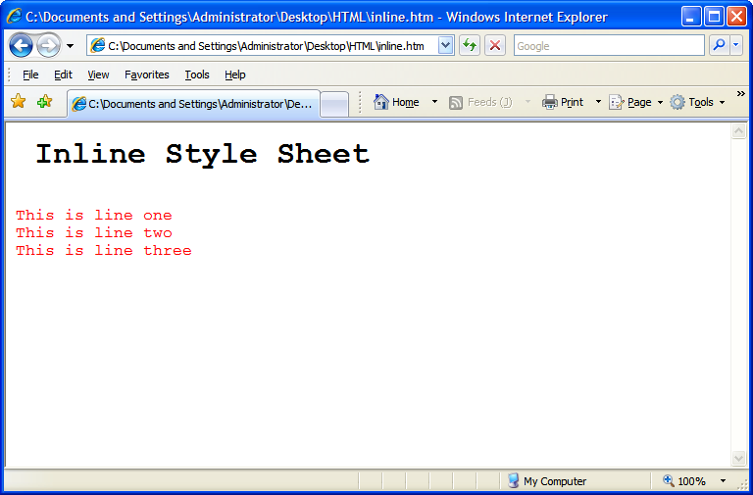
Inline Style Sheet(contd.)
<html>
<body>
<pre>
<h1> Inline Style Sheet</h1>
<p style="font-size: 12pt; color: red">
This is line one
This is line two
This is line three
</p>
</body>
</html>

Slide 8
Embedded Style sheet
Embedded style sheets are used when a unique style is required for a document.
Embedded style are defined in the <head> tag section by using the <style> tag
When a large number of style settings are used on a Web page, there is convenience in packaging the settings together in one place as an embedded style sheet, rather than having them scattered as inline style sheets throughout the document.

Slide 9
Syntax of Style sheet
selector {property: value}
Example
p {color: green}
If the value consist of more than one word the value has to be embedded within quotes.
p {font-family: “sans-serif”}
If more than one property needs to be defined then the properties need to be separated by semi colon.
p {font-family: “sans-serif” ; color: green}

Slide 10
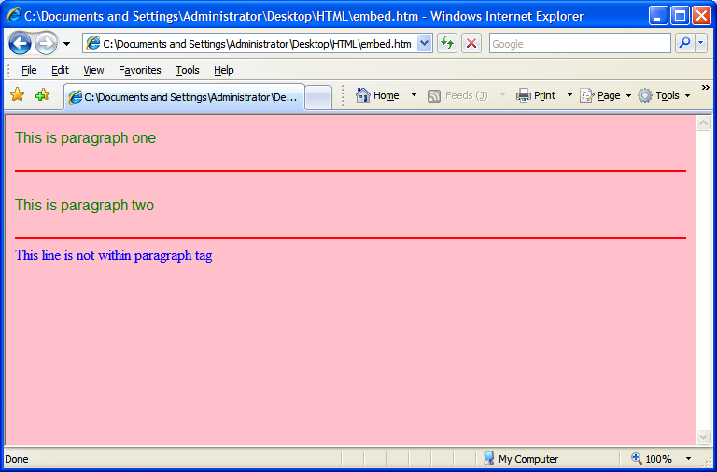
Example of an Embedded Style sheet
<html>
<head>
<style type="text/css">
p {font-family:"sans-serif"; color: green}
hr {color: red}
body {color:blue; background-color:pink}
</style>
</head>
<body>
<p>This is paragraph one</p>
<hr>
<p> This is paragraph two</p>
<hr>
This line is not within paragraph tag
</body>
</html>

Slide 11
External Style Sheet
Internal style sheets are used when a unique style is required for a document.
Internal style are defined in the <head> tag section by using the <style> tag
The different selectors, their properties and values should be defined within the external style sheet.
The external style sheet should be saved within a file, with an extension of .css

Slide 12



External Style sheet
Background is defined
Paragraph font color is
defined
Horizontal color is defined
Requires the background,
Paragraph and horizontal
Rule setting defined
In Mystyle.css
Both the html files uses
<link rel="stylesheet" type="text/css" href=“Mystyle.css" />
FirstPage.html
Requires the background,
Paragraph and horizontal
Rule setting defined
In Mystyle.css
Mystyle.css
SecondPage.html

Slide 13
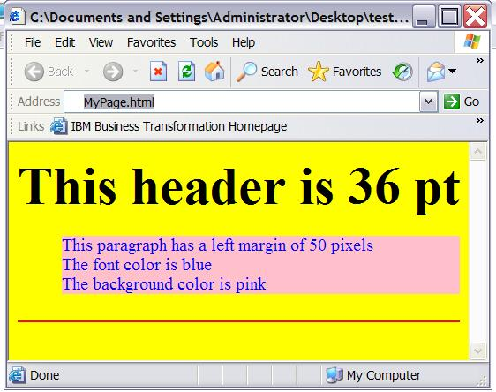
Example of External style sheet
body {background-color: yellow}
h1 {font-size: 36pt}
p {margin-left: 50px; background: pink; color:blue}
hr {color: red}
Mystyle.css
<html>
<head>
<link rel="stylesheet" type="text/css" href="Mystyle.css" />
</head>
<body>
<h1> This header is 36 pt </h1>
<p> This paragraph has a left margin of 50 pixels<br>
The font color is blue<br>
The background color is pink
</p>
<hr>
</body>
</html>
MyPage.html
MyPage.html is using styles
defined in Mystyle.css

Slide 14

Multiple Style sheet
<html>
<head>
<link rel=“stylesheet” type=“text/css” href=“Mystyle.css”>
<style type=“text/css”>
h3 {font-size: 20pt}
</style>
</head>
<body>
<h3> This is a header </h3>
---more text----
</body>
</html>
MyPage.html
h3 { color: red;
text-align: left;
font-size: 8pt }
Mystyle.css
Mypage.html Links to
Mystyle.css
The font size of <h3> is redefined here
What will be the Font size
Of <h3>
8pt or 20 pt??

Slide 15
Multiple Style sheet Continued
        If some properties have been set for the same selector in different style sheets, the values will be inherited from the more specific style sheet .
The HTML will inherit the
Font color and alingment
From Mystyle.css
<html>
<head>
<link rel=“stylesheet” type=“text/css” href=“Mystyle.css”>
<style type=“text/css”>
h3 {font-size: 20pt}
</style>
</head>
<body>
<h3> This is a header </h3>
---more text----
</body>
</html>
MyPage.html
Font Size will be Inherited
From the Internal Style sheet
h3 { color: red;
text-align: left;
font-size: 8pt }
Mystyle.css
Color: Red
Text-align-left
Font-size- 20pt

Slide 16
Some common selectors and attributes
Selector | property
H1,H2,H3….. | font-size,Font-family,font-style , font-weight Color, margin
P | font-size,Font-family,font-style , font-weight Color, Background-color,text-align, margin
HR | color
body | Background-color, font-size,Font-family,font-style , font-weight, margin
Notes:
font-family: sans-serif/courier/times
Font-size: 20pt
Font-style: italuc/bold//regular
Font-weight: (sets the boldness of the font)
Font-weight : 900
The CSS margin properties define the space around elements. It is possible to use negative values to overlap content. The top, right, bottom, and left margin can be changed independently using separate properties. A shorthand margin property can also be used to change all of the margins at once.

Slide 17
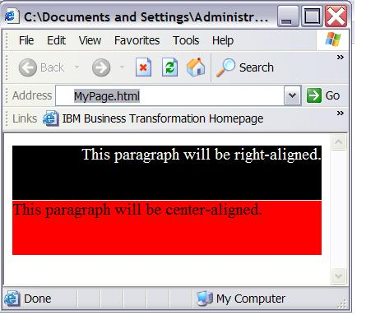
Class Selector
With the class selector you can define different styles for the same type of HTML element.
<html>
<head>
<link rel=“stylesheet” type=“text/css” href=“Mystyle.css”>
</head>
<body>
<p class=“one”>This paragraph is Right aligned </p>
<p class=“two”>This paragraph is Left aligned</p>
</body>
</html>
MyPage.html
p.one {text-align: right; color: white;
background-color: black}
p.two {text-align: left; color: black;
background-color: Red}
Mystyle.css

Slide 18

Uses of <DIV> Tag
1. <DIV> tag is a container for other tags.
2. DIV elements are block elements and work behind
the scenes grouping other tags together.
Some of the attributes of <DIV> tag are:
-> id
-> width
-> height
-> title
-> style
<DIV> tag
Notes:
When HTML first began, web creators only had two choices. A table layout, or frames. The div element provides a 3rd alternative, since a div can contain any/every other type of html element within its beginning and ending tag.
The div tag defines a division or section within an HTML .
span and div are the only elements that carry no innate semantic meaning, besides the logical grouping of the enclosed elements.
div and span differ from each other in one regard. In standard HTML, a div is a block-level element (and so visually isolates a section of a document on the page, in the same way as a paragraph, whereas a span is an inline element (for containing a piece of information inline with the surrounding text).

Slide 19
Uses of <DIV> Tag
<DIV> tag
Example
<div id="menu" align="right">
<a href="">HOME</a> | <a href="">CONTACT</a> | <a href="">ABOUT</a> | <a href="">LINKS</a></div>
<div id="content" align="left" >
<h5>Content Articles</h5>
<p>This paragraph would be your content paragraph with all of your readable material.</p>
<h5 >Content Article Number Two</h5>
<p>Here's another content article right here.</p>
</div>

Slide 20
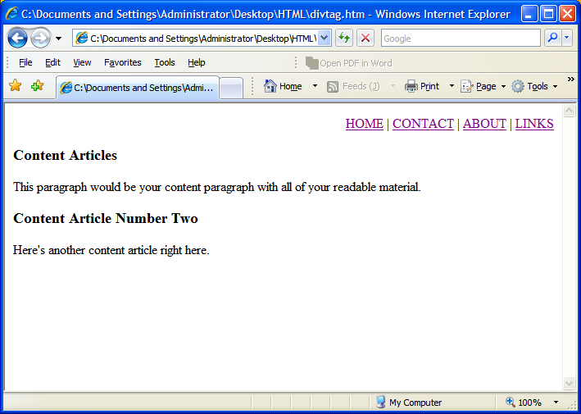
Uses of <DIV> Tag
<DIV> tag
Output

Slide 21
Using <span> in CSS
What is the
Utility of <span> in HTML
SPAN is a inline tag.
It is used to format small chunks of data within another element.
Combining <span> tag with CSS allows us to create custom tags.
Notes:
Do HTML rules cramp your style? Ever wish you could create your own tag what would behave just like you want? Well you can. Combine the SPAN element with CSS rules to create your own custom tags.
What does SPAN do? Nothing. That's the beauty of it. Since it has no defined display, you're free to write your own rules and apply them as you wish.
SPAN is an inline tag, which means that it's used to format small chunks of text inside another element. In contrast, a paragraph tag is a block-level element that can contain a number of inline elements like bold, italics, strong, and SPAN tags.

Slide 22
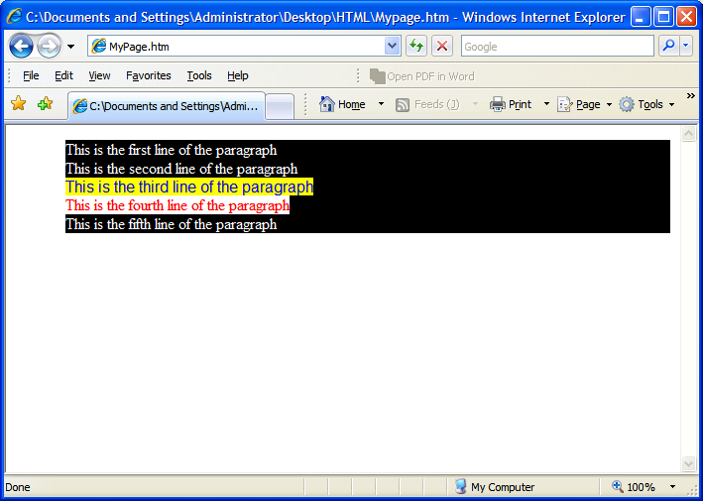
Using <span> in CSS (contd.)
<html>
<head>
<link rel="stylesheet"
type="text/css" href="Mystyle.css" />
</head>
<body>
<p >
This is the first line of the paragraph<br>
This is the second line of the paragraph<br>
<span class="example1">This is the third line of the paragraph<br> </span>
<span class="example2">This is the fourth line of the paragraph<br> </span>
This is the fifth line of the paragraph
</p>
</body>
</html>
MyPage.html
p { color: white ; background-color: black}
.example1 {color:blue ; background-color: yellow ;font-family: "sans-serif"}
.example2 {color:red ; background-color: white ;font-family: times}
Mystyle.css

